Slide 1
5 Game Ideas
Rodrigo Toledo Castillo

Slide 2
Touhou Fan Game
Genre: Bullet Hell (danmaku), Adventure, 2D Vertical Scrolling Shooter
Bullet hell mechanics from the main games such as: Graze, Spell cards and shooting modes.
Use of beautiful and difficult patterns on the attacks.
The style of music of the games that everyone loves.
Introducing OC for characters to the story.

Slide 3
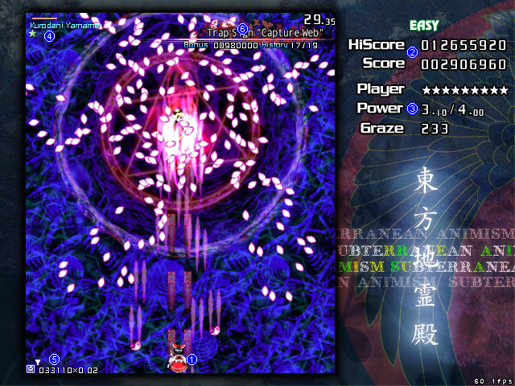

Slide 4
Bomb Mania
Genre: Puzzle, Strategy, Roguelike, Adventure, Survival
A random grid layout map with bombs currently hidden.
The different lives of the character do different things such as: skip two blocks, reveal where the bombs currently are in its surroundings, sacrifice itself and reveal random bombs in the map, etc.
Time and limited lives to try and cross the map.
The randomness of each level and difficulties that could be added into the game.

Slide 5
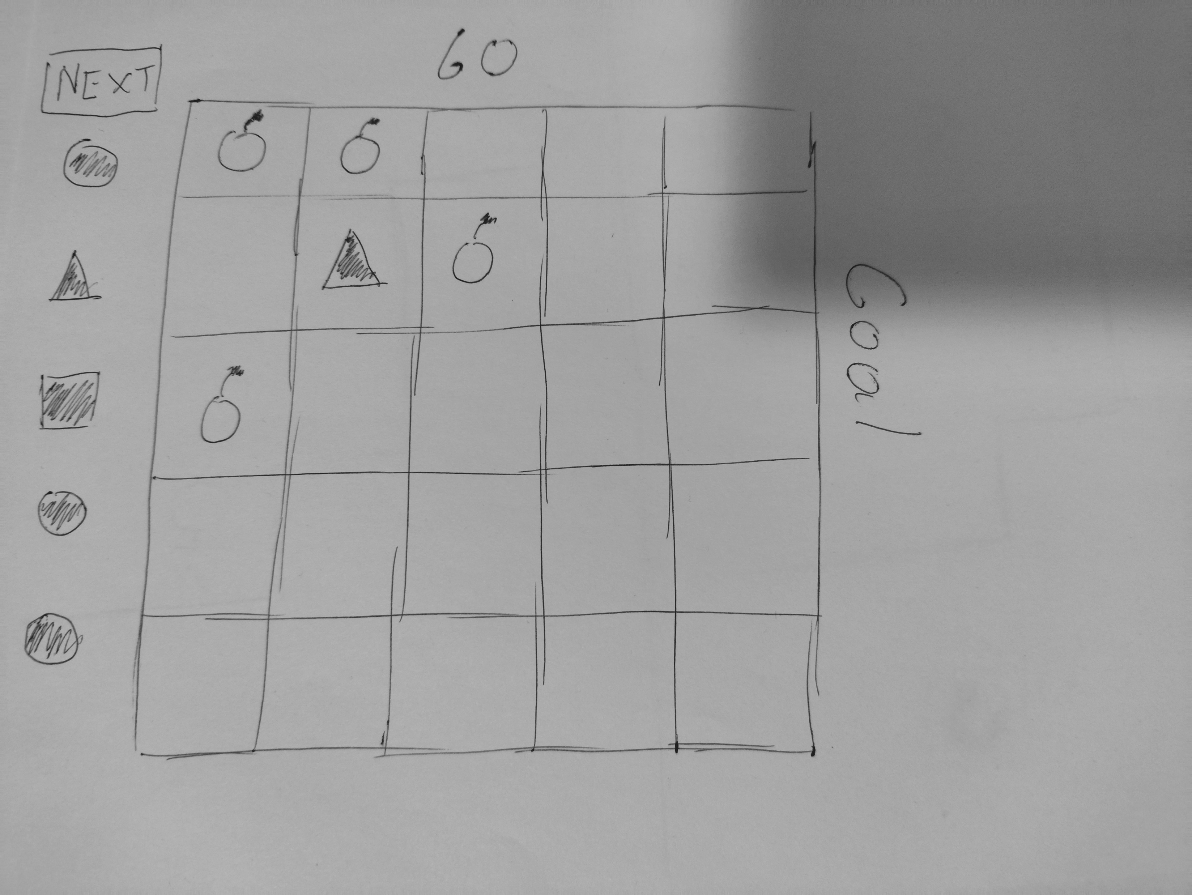

Slide 6
Speeding And Slowing
Genre: Physics-Based Puzzle, Action, Arcade, Skill-Based
Players pull back on the ball to launch it with the desired power and trajectory.
When the players grabs the ball mid-flight time slows down allowing the adjustment of the trajectory.
Reach the goal while avoiding the walls and obstacles with a time limit and count of how many pulls the player did.

Slide 7
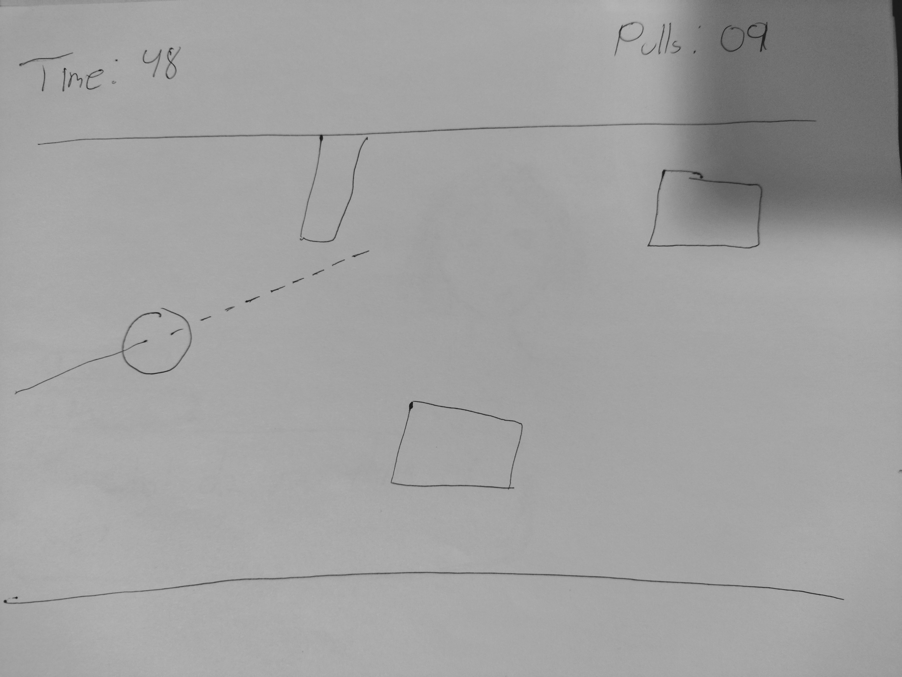

Slide 8
3 way to cross
Genre: 2D Platformer, Puzzle-Platformer, Metroidvania, Adventure
Three-Layered Gameplay:
Normal Layer: Standard movement and platforming.
Space Layer: Players can fly to higher platforms but have limited oxygen.
Heavy Layer: Increased weight allows breaking weak walls or moving heavy objects but much slower.
The idea to cross thought the levels using the different layers.
The metroidvania aspect of the game is certain weapons or unlocks the player could have to also help him travel trough the levels or even unlocking different layers.

Slide 9
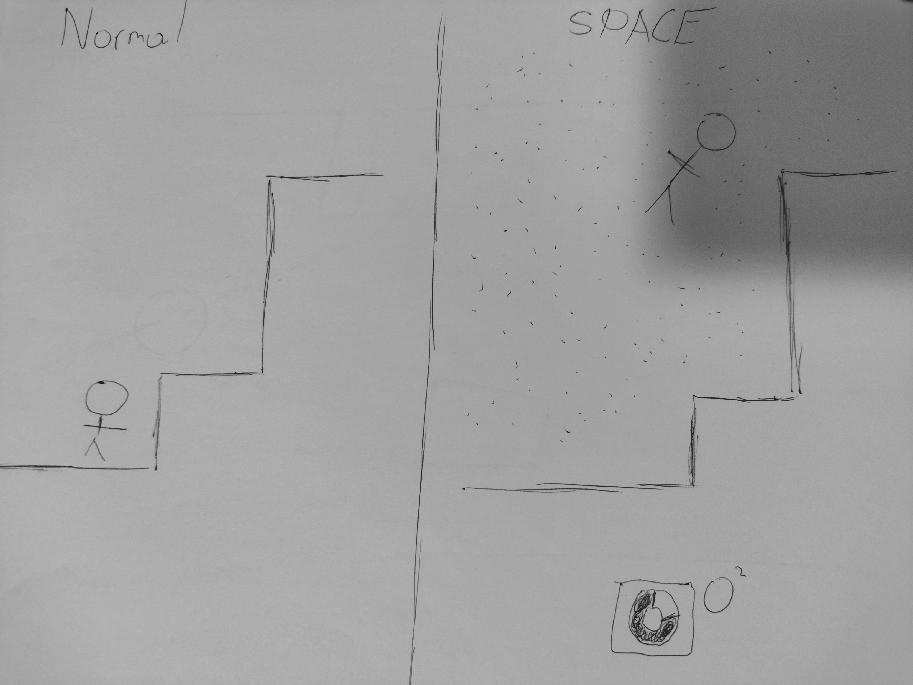

Slide 10
My Yo
Genre: Visual Novel, 2D Action, Phycological Horror, Romance, Puzzle
Takes inspiration from the phycological horror aspect from DDLC and MiSide.
The game has a slow start playing like a visual novel interacting with the girl called Yo.
As the player makes decisions and/or start making notes of things that are wrong the game will switch into a world were the player is pulled in.
The start of the “real” game is when the player finds himself locked into the room of Yo.

Slide 11

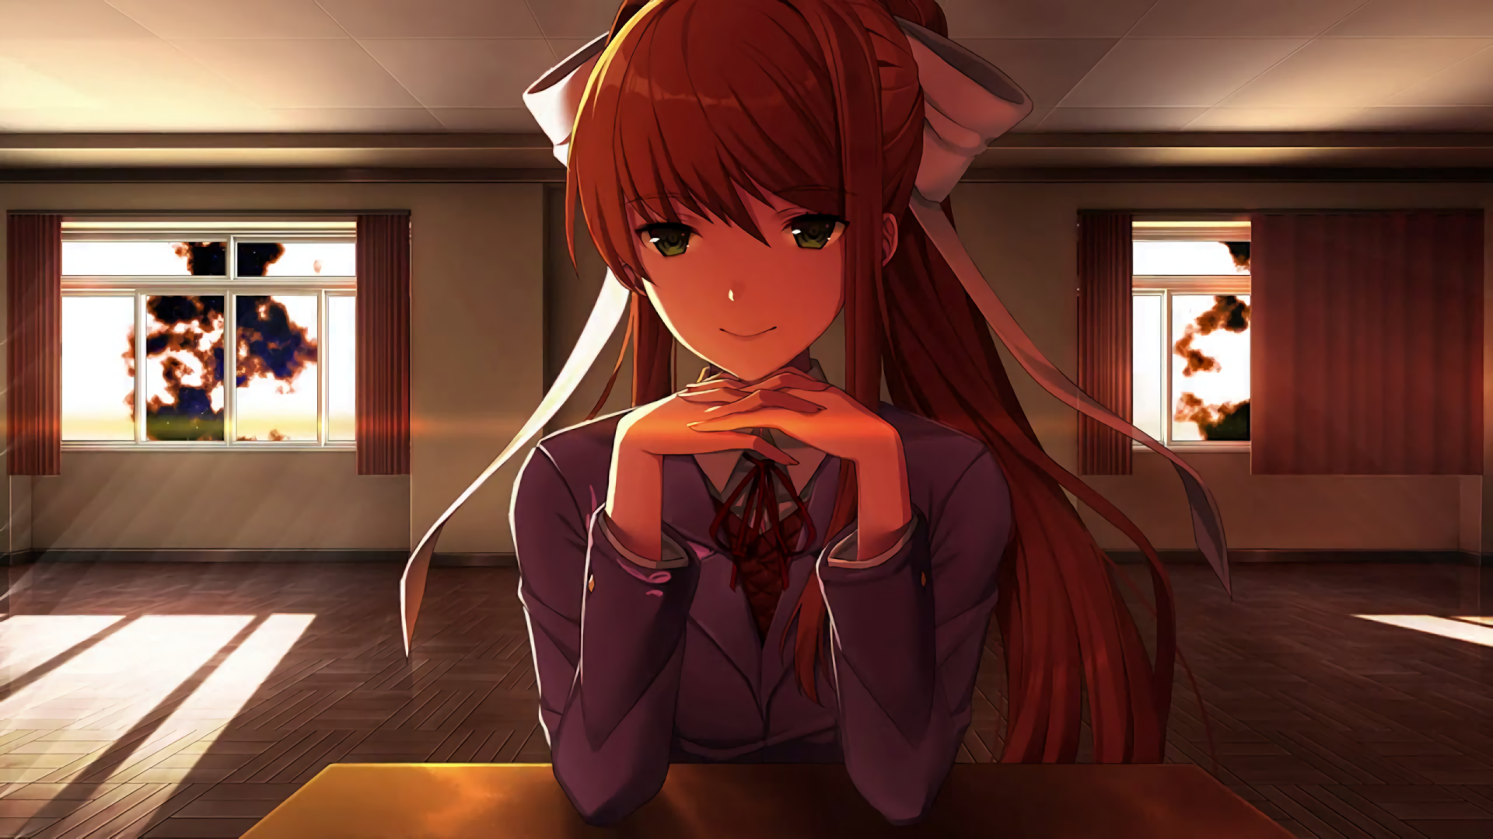

Slide 13
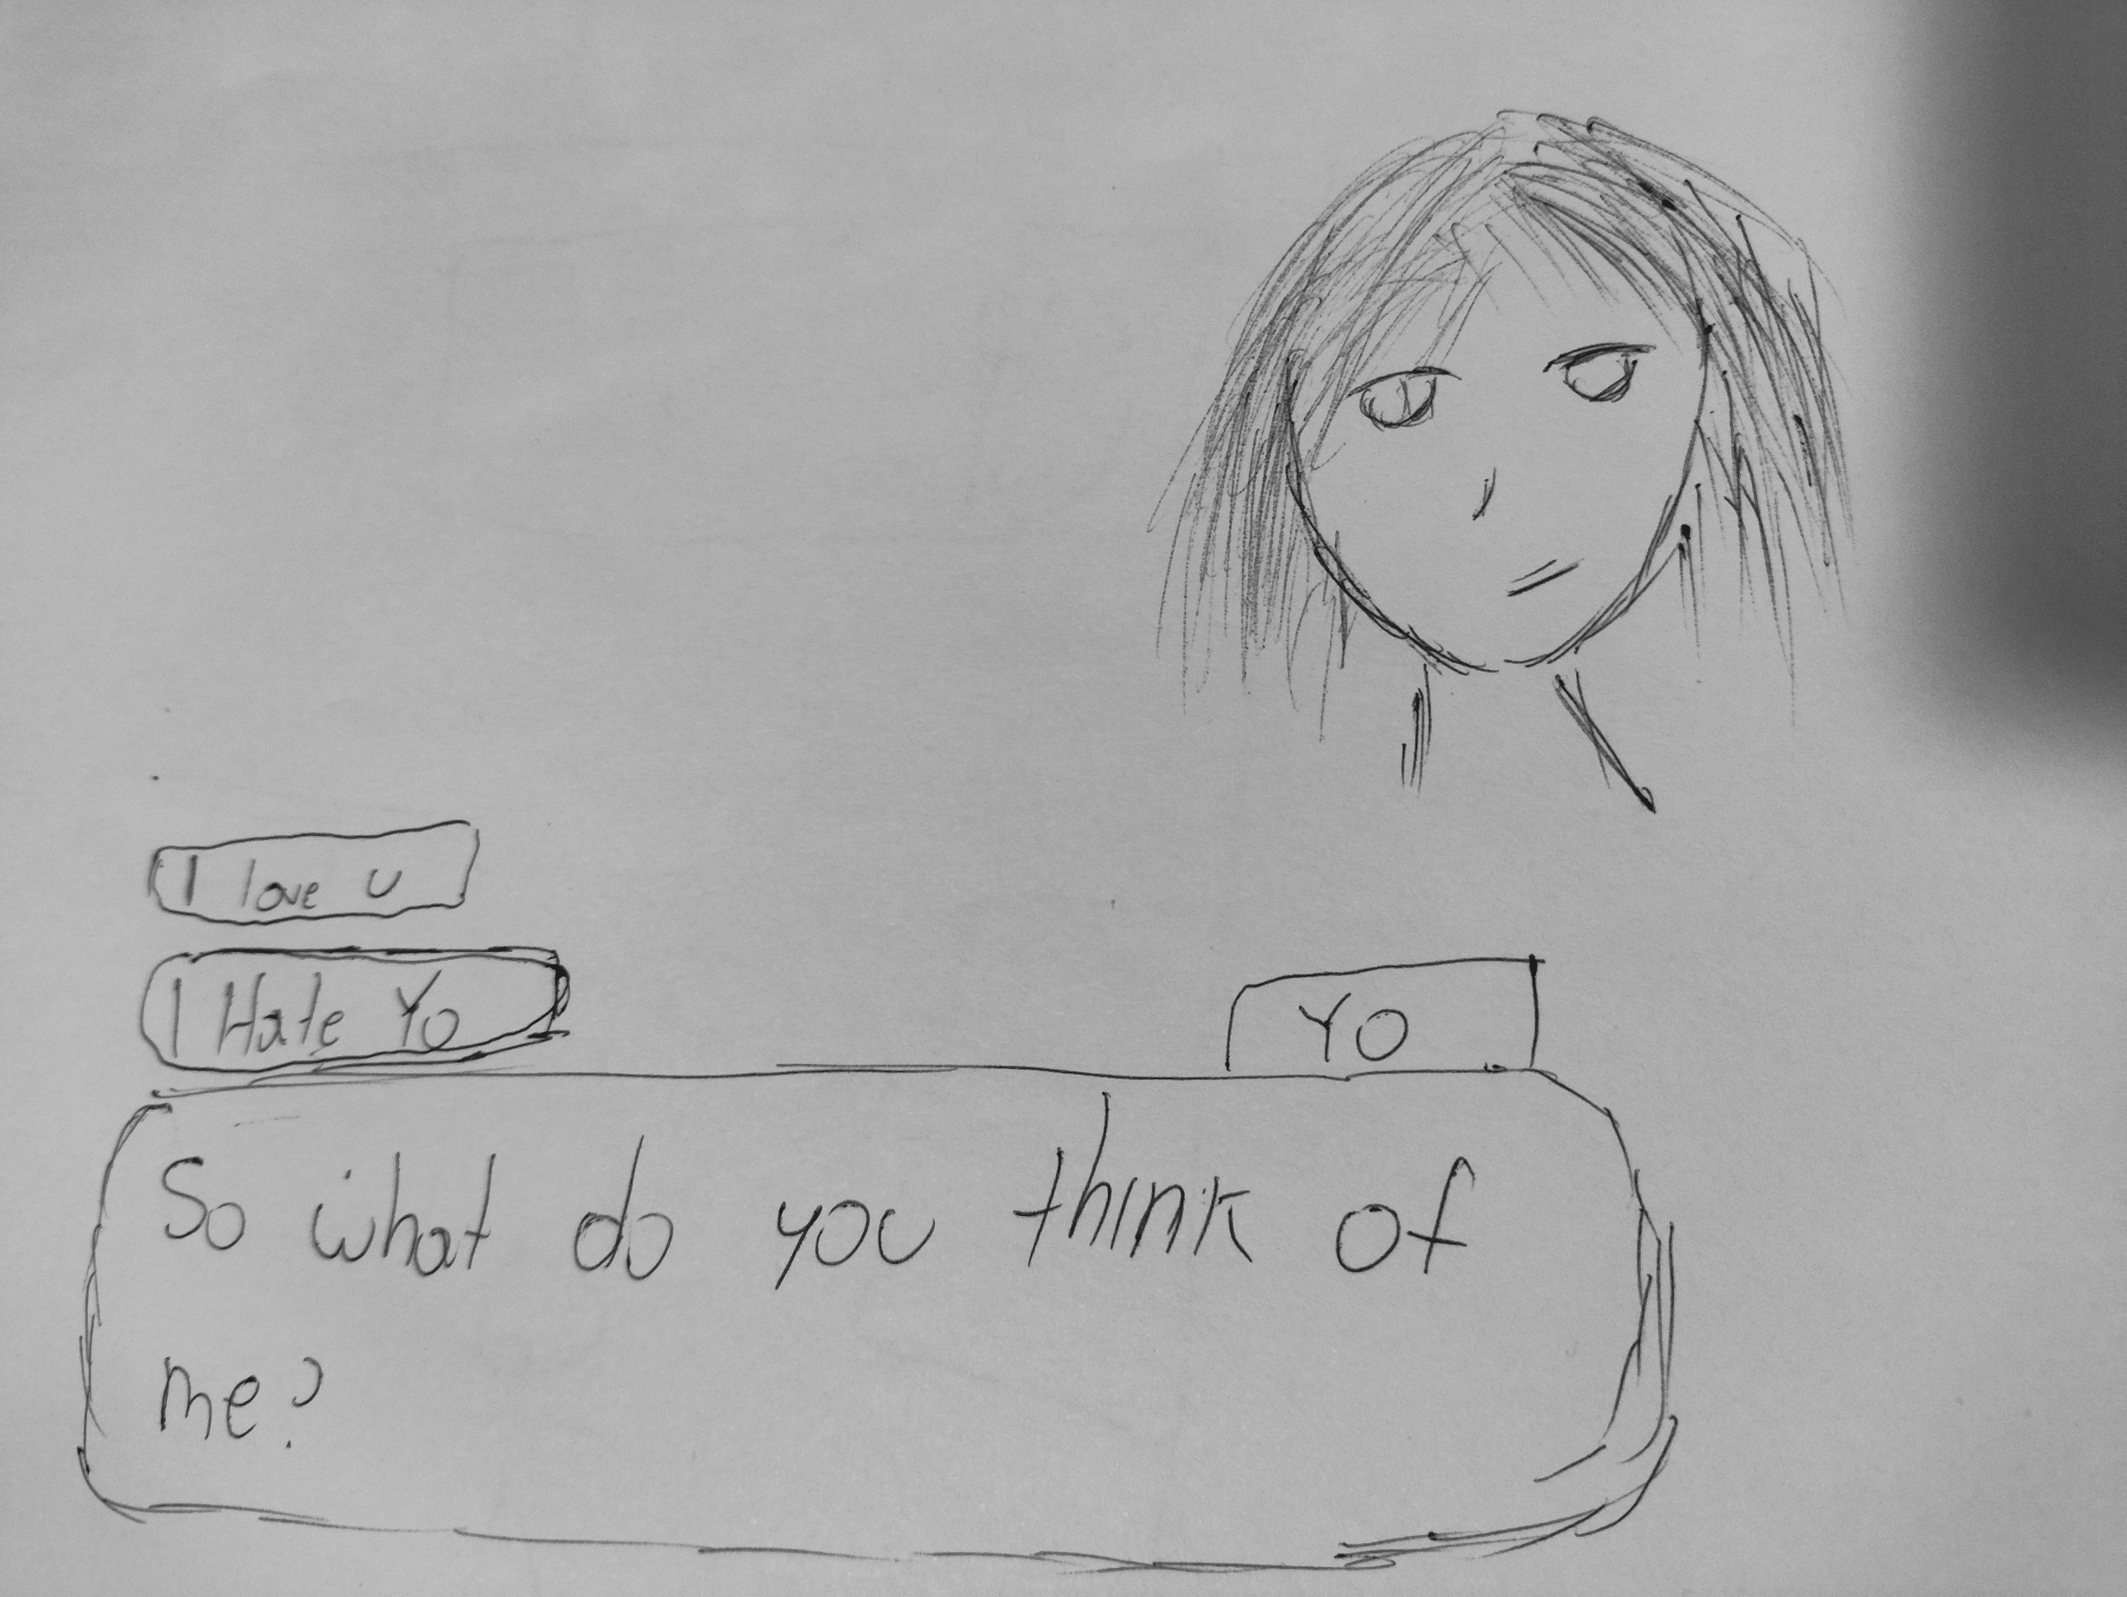

Slide 14
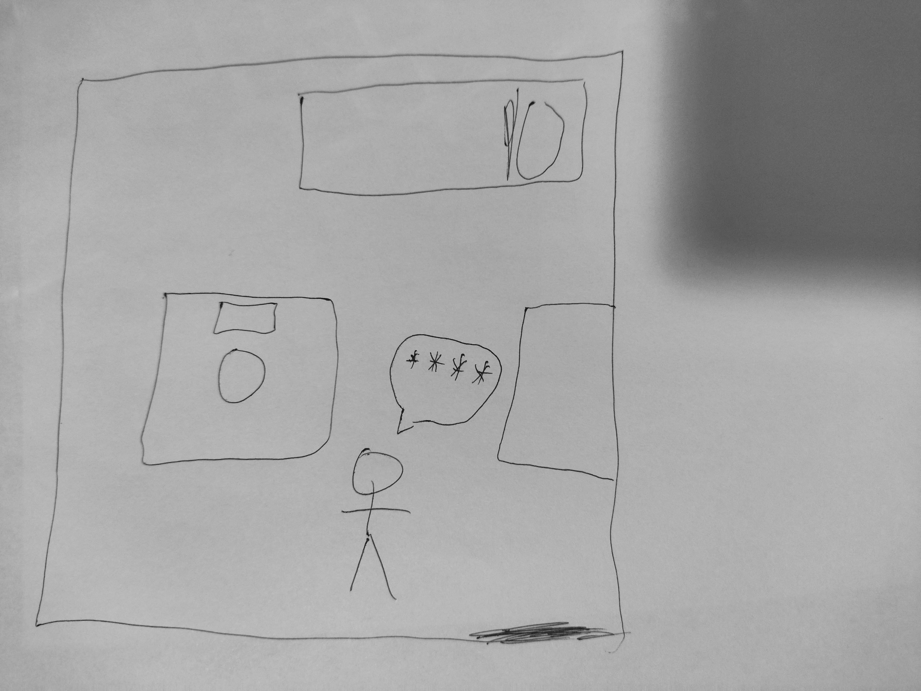

Slide 15
Thank you
Tenor. (n.d.). Mita Miside Crazy Mita Wave Anime. Retrieved from https://tenor.com/view/mita-miside-crazy-mita-wave-anime-gif-17704290304522993357 Tenor. (n.d.). Cappie Miside Yes No Copy GIF. Retrieved from https://tenor.com/view/cappie-miside-yes-no-copy-gif-5550817344992816888 Tenor. (n.d.). Mita Bonk Miside Yandere Bat GIF. Retrieved from https://tenor.com/view/mita-bonk-miside-yandere-bat-gif-6288493079499513940

